Slide 1
ANALYSIS OF MOBILE PHONE FEATURES AND PRICE
NAME ; MILLEE CHAUDHARY
TO; NEXTHIKES IT SOLUTIONS

Slide 2
INTRODUCTION
In today’s smartphone market, mobile prices vary based on features like RAM, battery, and camera quality.
This project focuses on analyzing mobile phone data to understand how different features affect the price.

Slide 3
OBJECTIVE
To analyze mobile phone dataset
To understand relationship between features and price
To visualize important patterns using graphs

Slide 4
DATASET DESCRIPTION
The dataset contains information about various mobile phones with features such as:
RAM
Battery
Rear Camera
Front Camera
Colour
Processor
Price (Prize column in dataset)

Slide 5
DATA PROCESSING
The dataset was cleaned before analysis:
Removed extra spaces from column names
Converted “Prize” column into numeric format
Removed “MP” from camera columns
Dropped unnecessary columns like Model, Indexer, etc.
Removed missing values

Slide 6
DATA VISUALIZATION
Different graphs were used to analyze the data:
Heatmap
Shows correlation between important features and price.
Histogram (Displays distribution of mobile prices).
Scatter Plot ((RAM vs Price) Shows how RAM affects price).
Scatter Plot ((Battery vs Price) Shows how battery capacity affects price).

Slide 7
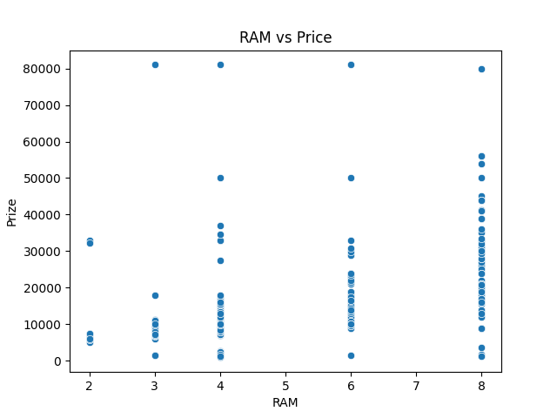
RAM VS PRICE (SCATTER PLOT)
This graph visualizes the relationship between a phone's memory and its cost.
​Observation: As RAM increases from 2GB to 8GB, the price range expands significantly. While there are budget options at almost every RAM level, the highest price points (near 80,000) are almost exclusively occupied by phones with 8GB or higher.
​Insight: There is a positive correlation here, but it isn't perfectly linear. This suggests that while more RAM usually means a higher price, other factors also play a role in making a phone "premium."

Slide 8
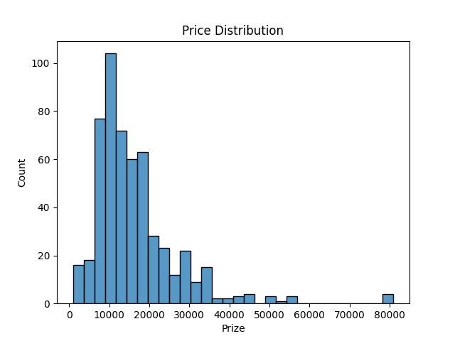
PRICE DISTRIBUTION (HISTOGRAM)
​This chart shows how many phones fall into specific price brackets.
​Observation: The data is Right-Skewed. A massive majority of the phones are clustered in the 10,000 to 20,000 price range. As the price goes higher, the number of available models drops sharply.
​Insight: The dataset represents a market dominated by "Budget" and "Mid-range" devices. The phones priced above 50,000 are statistical outliers, representing the luxury/flagship segment.

Slide 9
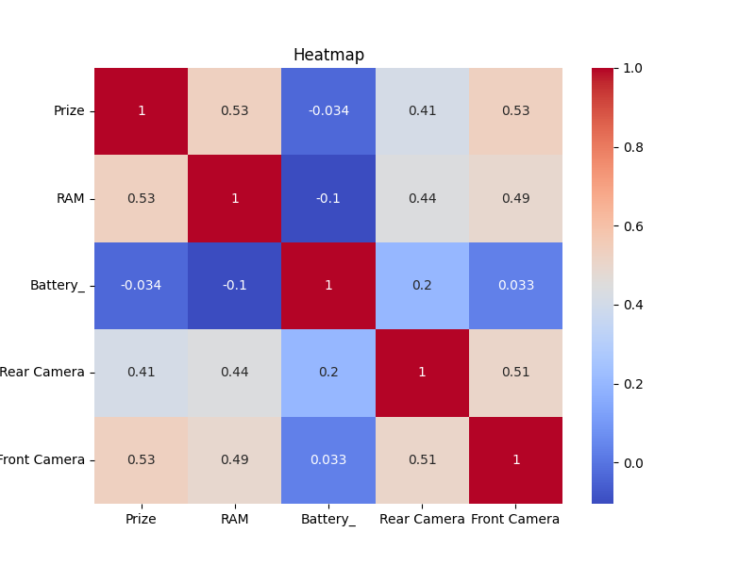
CORRELATION MATRIX (HEATMAP)
This is the most critical tool for understanding which features actually "drive" the price.
​Key Correlations with Price:
​RAM (0.53) & Front Camera (0.53): These have the strongest positive correlation with price.
​Rear Camera (0.41): This has a moderate impact on the cost.
​Battery (-0.034): Surprisingly, battery size has a near-zero/slightly negative correlation with price.
​Insight: This proves that manufacturers charge a premium for performance (RAM) and selfie quality (Front Camera), rather than battery capacity.

Slide 10
OBSERVATION
Based on the statistical evidence from these graphs, we can conclude the following:
​Price Determinants: RAM and Front Camera quality are the primary predictors of a smartphone's price. If a phone is expensive, it is highly likely to have high RAM and a high-end front camera.
​The Battery Paradox: Battery capacity is not a premium feature. In fact, large batteries are often found in cheaper, bulkier "budget" phones, whereas expensive flagship phones might prioritize slim design or fast charging over raw battery size.
​Market Focus: The "sweet spot" for the market is the 10k-20k range. Manufacturers focus most of their volume in this area.
​Feature Bundling: There is a strong correlation (0.51) between Front and Rear cameras, meaning that if a manufacturer upgrades one, they usually upgrade the other, collectively driving the price up.

